Slide 1
Data Analytics Case Study Portfolio
Noah Vaknin

Slide 2
About Me
Overview
Values
Traits

Slide 3

Overview
I am recent graduate from Binghamton University who majored in financial economics and am eager to work in a role where I can apply my strong analytical skills, ability to focus on the details and commitment to a positive outcome. My academic training along with my part-time experience at Northwell Health has given me a well-rounded understanding of problem solving, time management and the ability to work well in a team environment
During my internship I had the opportunity to work with finance professionals where I was responsible for reviewing financial statements to identify variances to budget, optimizing KPI reports and consolidating data to prepare and plan for an IT systems transition. In addition, the courses that I have taken in accounting, finance, statistics, and economics have provided me with a solid foundation for this role. Lastly, I am currently enrolled in CareerFoundry’s data analytics program where I’ve gained practical skills in Microsoft Excel, Tableau, SQL, Python, and GitHub.

Slide 4

Values
Hardworking – I approach every task with dedication and persistence,
ensuring that I put in the effort needed to achieve the best results.
Detail-Oriented – I pay close attention to the finer details,
making sure that nothing is overlooked and that my work is thorough and accurate.
Accepting – I value different perspectives and
create an inclusive environment where everyone feels respected and heard.

Slide 5


Interests
Lifting Weights – Committed to strength training and personal fitness.
Basketball & Football – Enjoy following and playing both sports.
Cooking – Love experimenting with new recipes and flavors.

Slide 6
Projects
Influenza
Influenza
Rockbuster
Instacart
Pig E Bank
UFC Project

Slide 7






Introduction
The CareerFoundry Data Analytics program is a comprehensive, hands-on course designed to equip students with the skills and tools needed to excel in data-driven roles. Over the course of the program, I’ve gained expertise in:
Microsoft Excel for data cleaning, analysis, and visualization
SQL for database management and querying
Tableau for creating interactive dashboards and visualizations
Python for advanced data analysis and automation
GitHub for version control and collaborative work

Slide 8
Game Co.

Slide 9

Game Co.
Overview: Game Co is a newly established video game company aiming to leverage data analysis to gain insights into market trends, shape effective strategies, and drive growth in the most sustainable markets.
Methods:
Grouping data
Summarizing data
Descriptive analysis
Visualizing results in Excel
Presenting results
Objectives:
Analyze the popularity of games, competitor publishers, and sales trends across various genres, time periods, and regions
Deliver actionable insights to inform Game Co’s game development and market strategies.
Data:
Historical video game sales data (for titles with over 10,000 copies sold) across various platforms, genres, and publishing studios, sourced from the website VGChartz.
Tools Used

Slide 10
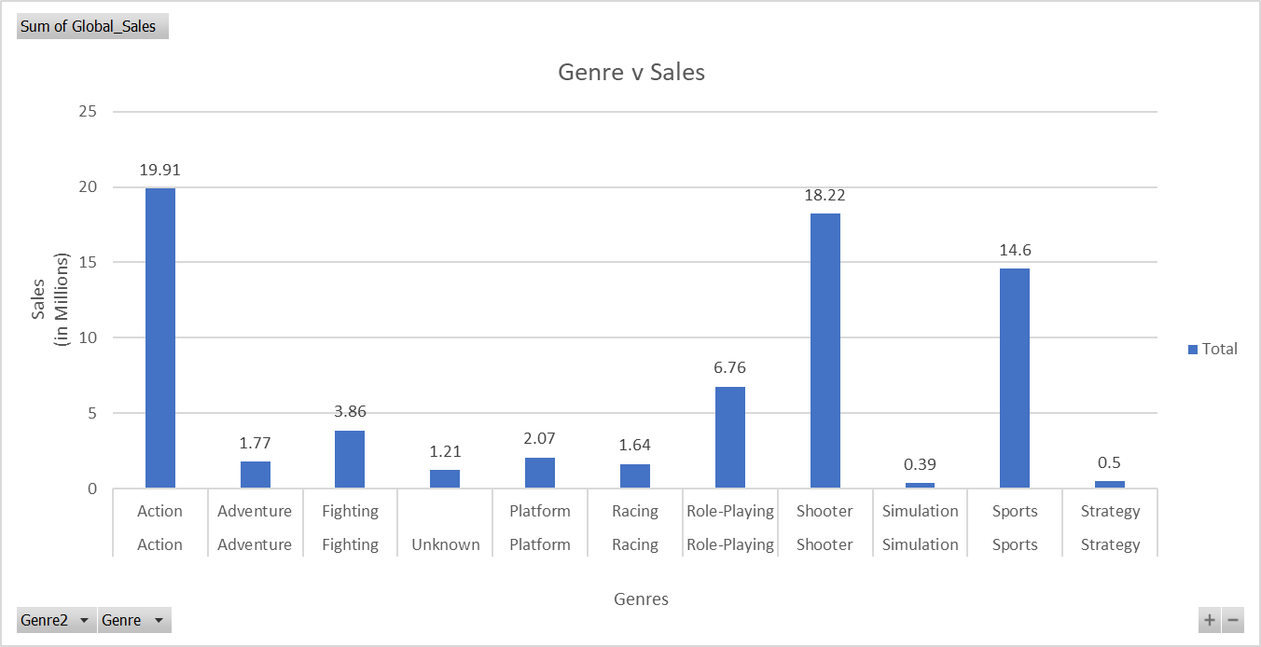
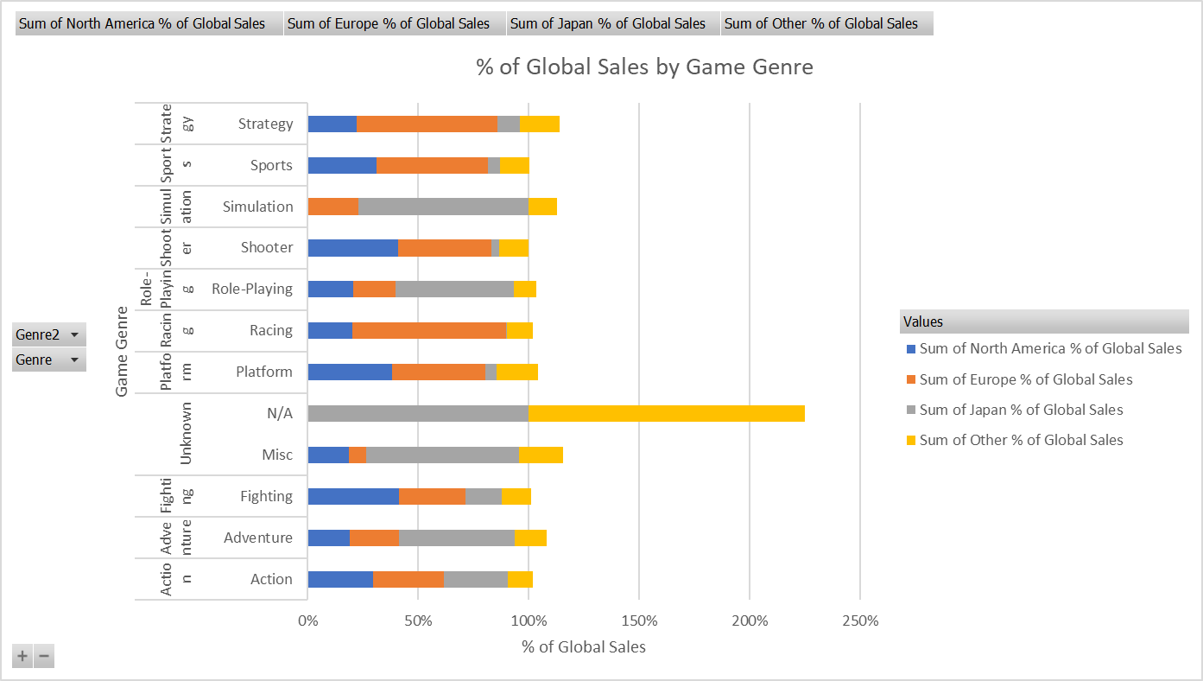
Analysis
Global Video Game Genre Popularity
Gaming Platform Popularity by Region
This is the first time we really see a trend from before 2016 hold through 2016. Just like prior years, Action, Shooter, and Sports games are the three most popular genres.
As stated in the previous slide, Action, Shooter, and Sports games were the three most popular genres. Coupling that with the fact that Europe makes up most of the global sales, it makes sense that we see Europe dominate the sales of the three most popular game genres in 2016.

Slide 11
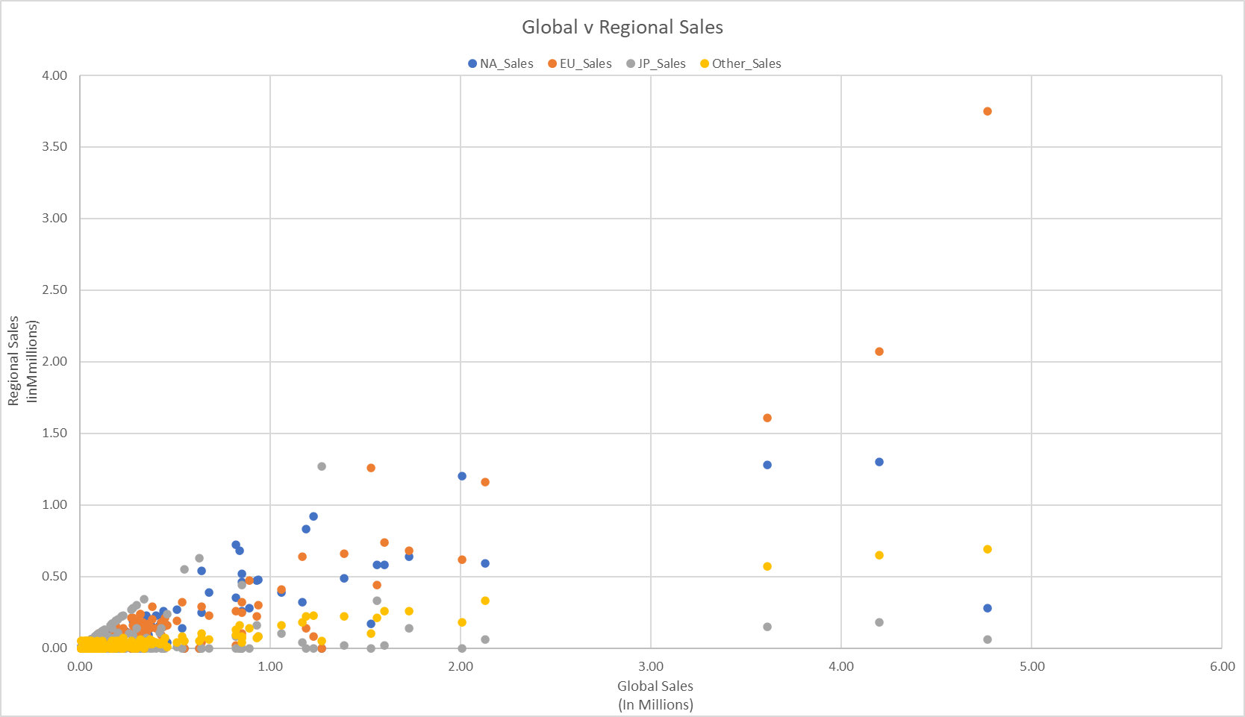
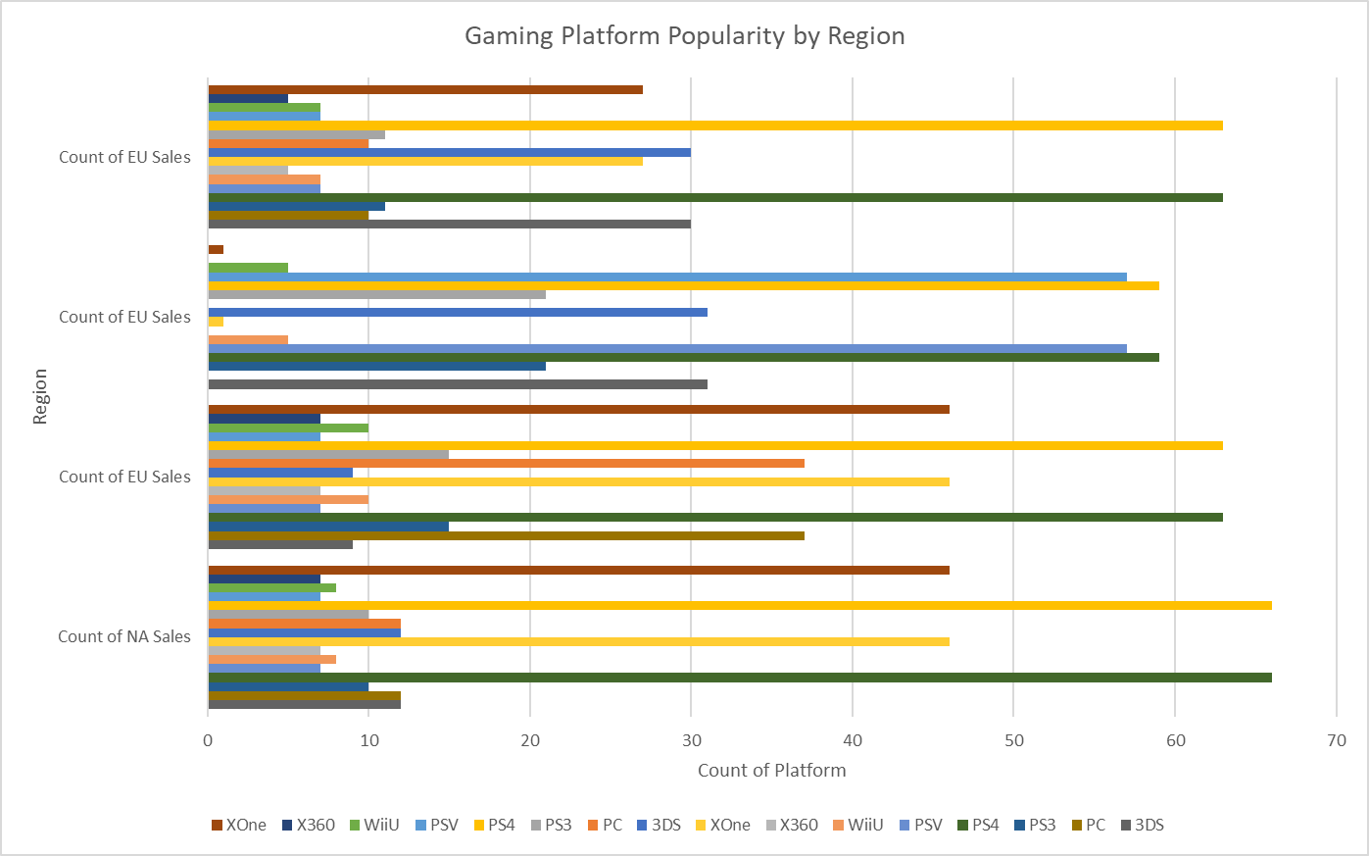
Analysis
Distribution of sales by region
Game Genre Popularity by Region
This plot helps us to understand that as opposed to the past 35 years where North America has been the catalyst of global sales, the tide is shifting. In 2016 Europe has the largest % of global sales as seen in this scatter plot.
Being that all these platforms weren’t created during the beginning of the data capture, it would make sense why GameCo wouldn’t have a good grasp on platform trends. However in 2016, PS4 is by far the leading platform in every region. Games played on the PS4 are more likely to increase sales by the greatest margin.

Slide 12
Summary
Unlike the past 35 or so years, how GameCo looks at the video game market landscape in terms of regional sales should shift as we now see Europe beginning to take over North America for highest % of global sales. Along with this change, a shift in platform usage has also contributed to different sales distribution. With the addition of the PS4 in 2013 and to a lesser extent, the xbox 1, the distribution of platforms on which people game on has changed. This change is reflected in the games that people buy specifically, shooter games. Although I did state that shooter games have been one of the three most popular game genres over the past 35 years, their popularity relative to the other genres has seen the sharpest increase in 2016. One thing that hasn’t really changed and holds true in 2016 is that action, sports and shooter games remain to be the 3 most popular genres of game.

Slide 13
Recommendations
The most important change GameCo must make when considering the gaming market is how they view both Europe and North America.
Europe has seen a steady increase in their share of the global market while North America has seen the opposite
This being said, GameCo should start allocating more games to Europe to meet the growing demand, In particular, games that are of the action, sports, and shooter variety.
These games should be available on the PS4 as it is the most popular
It is also important that these games not only be playable on PS4 but across other platforms as this increase the However, of consumers you can sell the game to.
However you do still want to allocate recourse to North America as it your second largest market and has very similar game preferences to Europe.
When it comes to Japan, there game preferences differ tremulously from that of Europe and North America with the exception of action games.
This is good as the two most popular game genres in Japan are simulation and role-playing. These genres aren’t that popular in the other regions so you can allocate a lot of those games to Japan

Slide 14
Preparing for Inuenza Season
Influenza

Slide 15

Influenza
Overview: In the United States, flu season leads to a significant rise in influenza cases, with high-risk groups often experiencing severe complications that require hospitalization. To manage the increased patient load during this period, healthcare facilities depend on temporary staffing solutions provided by medical staffing agencies.
Objectives:
Analyze influenza seasonality
Prioritize states based on the proportion of vulnerable populations
Determine the timing and number of staff needed for each state.
Data:
The U.S. Census data is an extensive dataset compiled by the United States Census Bureau, offering detailed information on the population, demographics, economy, housing, and social characteristics of the U.S. population.
Methods:
Data Transformation
Data Intergration
Data Profiling
Statistical Analysis and Testing
Forecasting and Spatial Anaylsis
Data Visualization and Storytelling
Tools Used

Slide 16
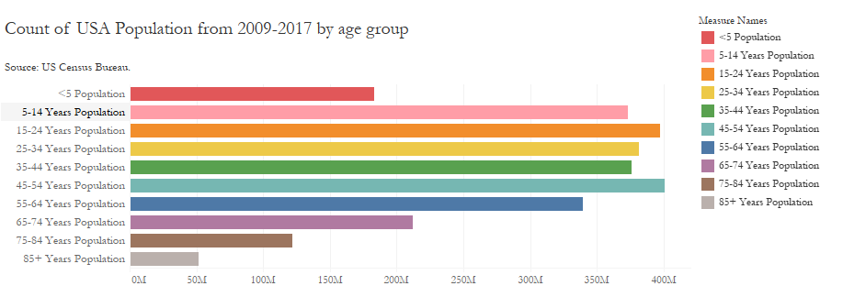
Visual 1

Slide 17
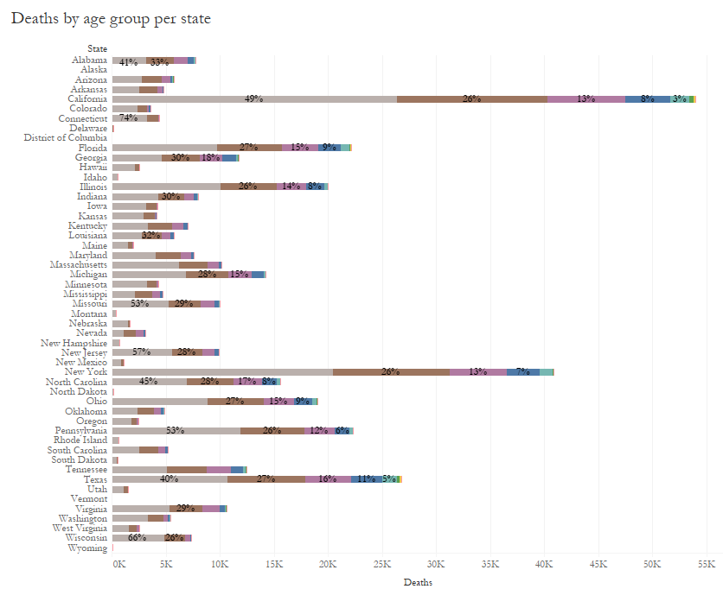
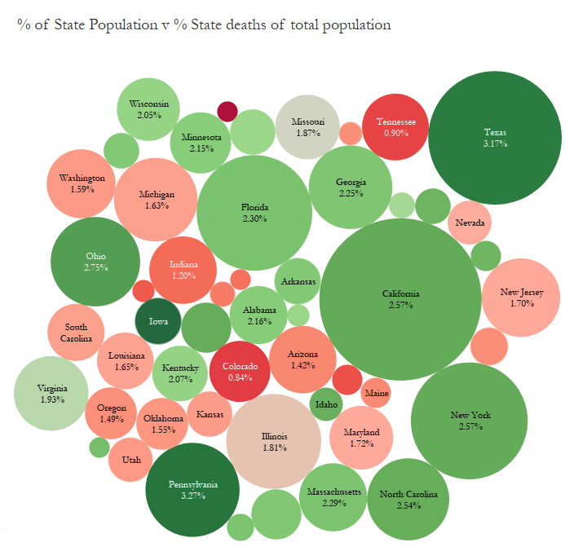
Visuals 2&3

Slide 18
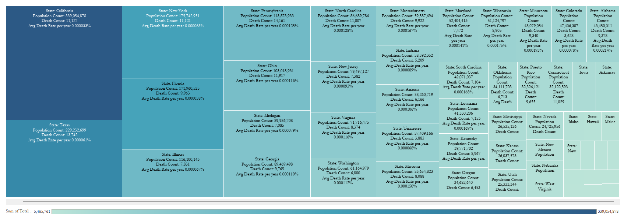
Visual 4
State Size Population and Mortality Overview

Slide 19
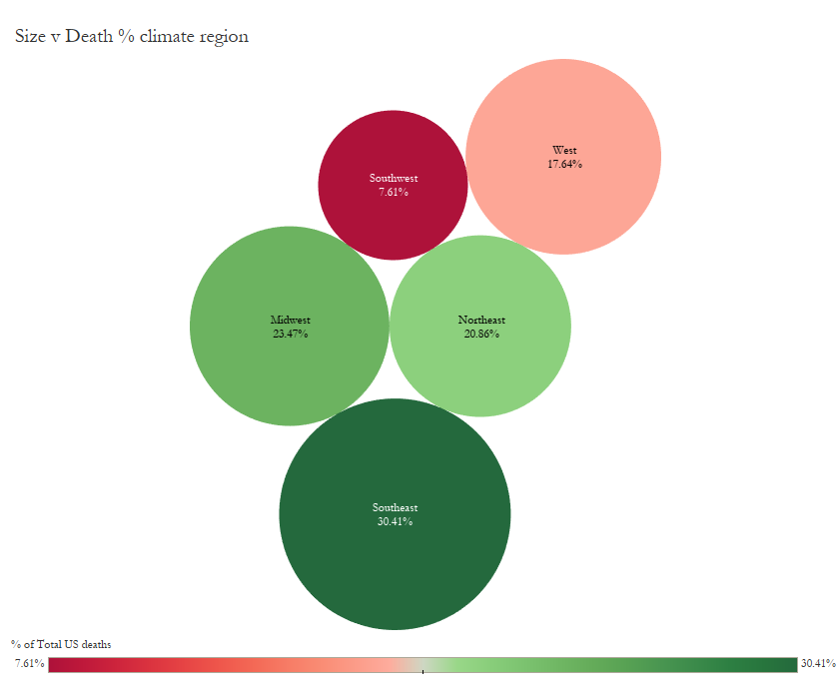
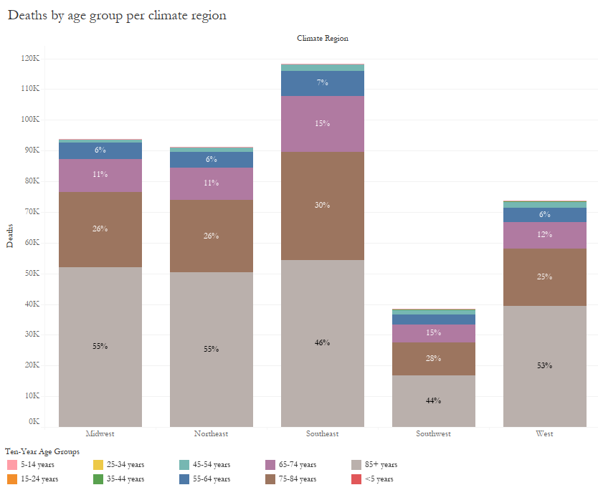
Visuals 5&6

Slide 20
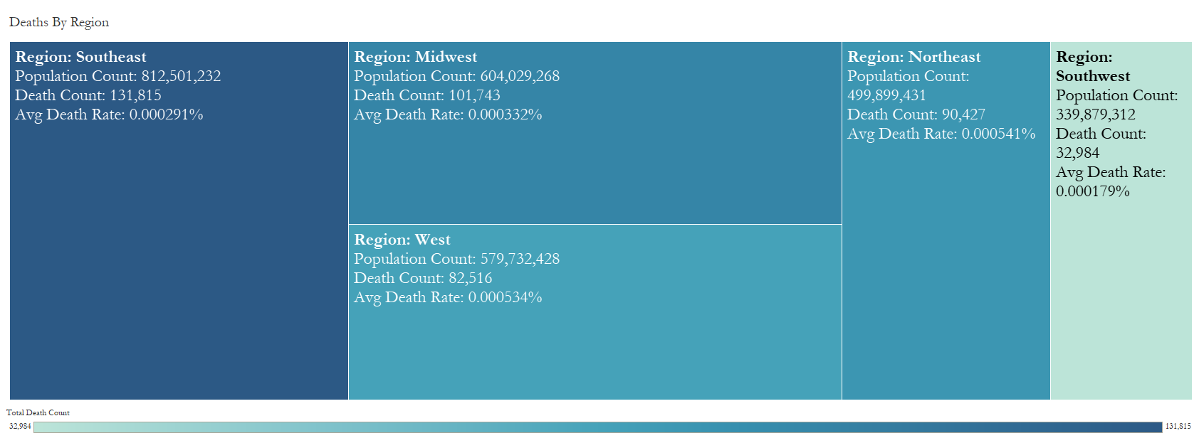
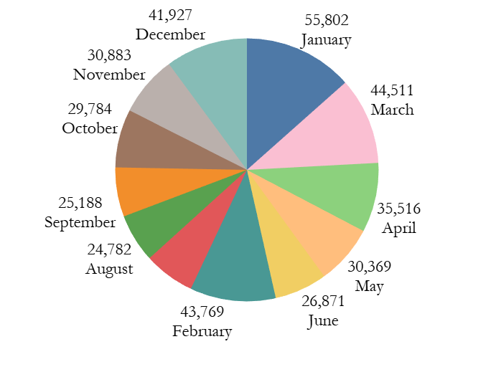
Visual 7&8
Deaths By Month

Slide 21
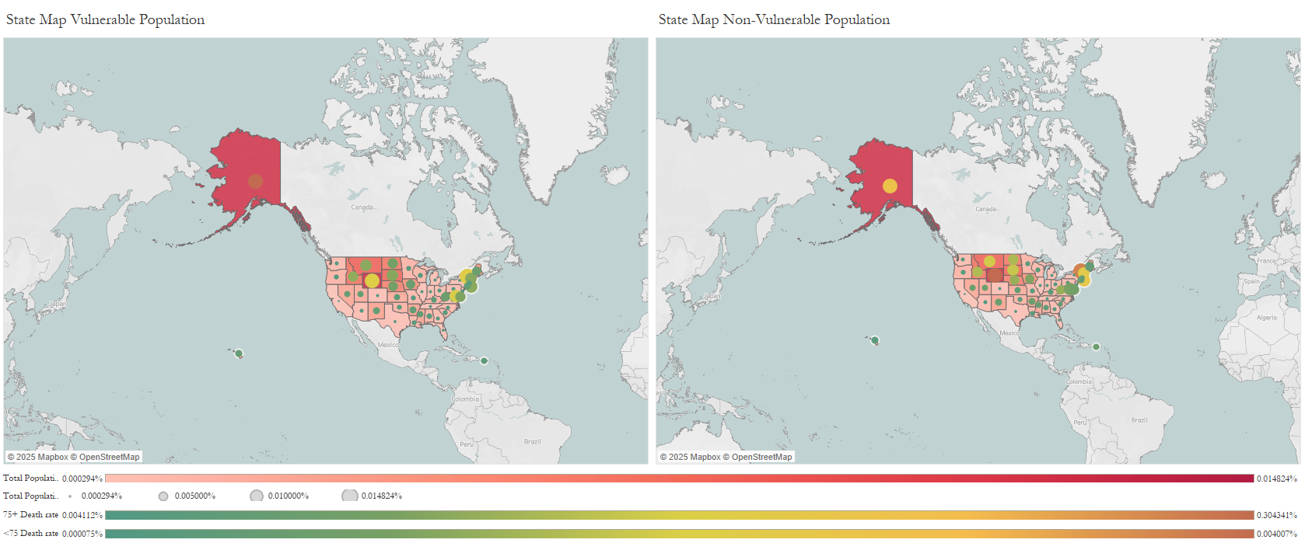
Visuals 9&10
Geographic Mortality Distribution

Slide 22
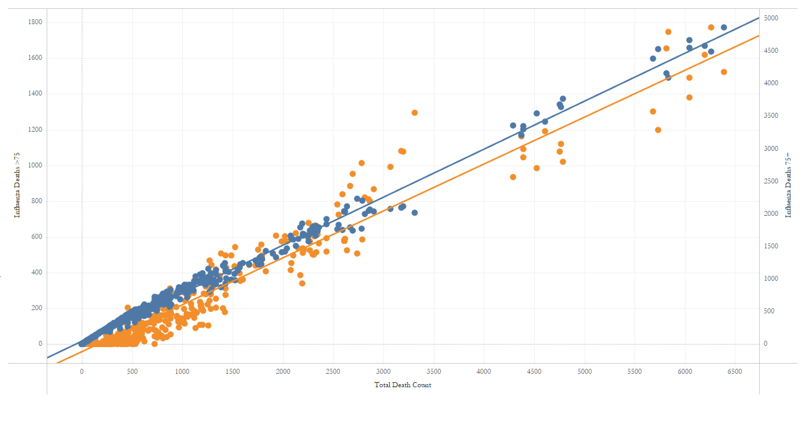
Analysis
What Were seeing:
In this dual axis scatter plot of total deaths compared to deaths of people older and younger than 75, We can see that the deaths of people older than 75 are more clustered around the trend line compared to that of younger than 75. With an R-squared value close to one at .99 we can assume that the correlation between being older than 75 and dying from influenza is pretty strong. Another important thing to note is that while the R-squared value of the younger than 75 group is strong at .94, this likely just results from the sheer volume due to the fact that it's a much wider age range then that of people older than 75. If you look at most of the histograms, the age groups of 85+ and 75-84 make up a majority of the deaths combined while the age group of 65-74 also makes up a decent portion of the deaths. Including people in the 65-74 age range may be beneficial to this study however, you can still see that for the most part the older two groups are usually almost double the 65-74 age group. Another important thing to note is that the death count on the Y axis for people older than 75 is much greater than that of the people under 75.

Slide 23
Insights and recommendations
Insights:
When it comes to the vulnerable population, we have determined that people over the age of 75 are considered the most vulnerable to die from influenza. This statement is heavily supported by various visuals throughout the presentation. This is not to say that this is a perfect grouping. It could be beneficial to expand this group to include people 65 and older however, for now, we are content with this age group. Although we now know that the more "elderly" population is more vulnerable to influenza, looking at other factors can vastly increase the effectiveness of our staffing plan.
Other Findings:
In terms of findings unrelated to age, we found that a lot of the larger more populated states such as California, New York, and Texas, had a higher death count. However, being that these states are more populated, that makes sense. What we really wanted to know was which states' deaths made up a higher % of total deaths than their population made up of the total US Population. What we found was that a lot of mid western states, Ohio, Illinois, Indiana, Iowa, Kansas, Michigan, Minnesota, Missouri, Nebraska, North Dakota, South Dakota, and Wisconsin, all achieved this metric. Another variable we decided to look at was seasonality. To no surprise, we found that the winter months, December, January, and February, had the most ever-changing of deaths.
Recommendations:
When it comes to how we should adequately staff, we should first consider the populations with the most at risk, 75+, as these people are the most vulnerable. Being that larger more populous states have more people it is also important to have these more population dense states equipped to deal with the sheer size of their population. We also need to consider a region like the Midwest because although it may not be as populated, their deaths are a larger % of the total population deaths than their population is to the total US population. This is most likely caused by lower expectations due to their volume of people. Lastly, we must make sure that we have a sufficient number of staff in the winter months as this is the season where the mortality count is the highest. Additionally, we will continue to monitor the situation and see if we get any data that will affect the current staffing plan.
Preventative Measures:
To help prevent the spread of the Flu (Influenza) we can encourage citizens to get vaccinated, especially people who reside in states with high population density. Other things are to encourage cleanliness practice such as washing of hands and covering the mouth when sneezing or coughing. It's not just everyday citizens that help prevent it though. Making sure staff members are dressed properly and are also practicing proper cleanliness habits will also help to ensure that the flu doesn't spread.
Looking Ahead:
In terms of the next step, I've brought up expanding our target group of people 75+ to include people 65+. I didn't seem to find this completely necessary at the moment however, with continuous monitoring and ever-changing data, this may be beneficial to increase the accuracy of our study and overall effectiveness of our staffing plan.

Slide 24
Rockbuster Stealth Data Analysis Project
ROCKBUSTER

Slide 25

RockBuster
Overview: Rockbuster Stealth LLC, a former global movie rental chain, is planning to launch an online video rental service to stay competitive against streaming giants like Netflix and Amazon.
Objectives:
Identify top-performing movies and customer preferences to maximize revenue
Examine rental durations and geographic sales trends to refine market strategies
Locate high-value customer regions to guide targeted marketing initiatives
Data:
Dataset that contains information about Rockbuster’s film inventory, customers, and payments.
Methods:
Microsoft SQL Management Studio
Data Cleaning and Filtering
Joining Tables
Subqueries and CTEs
Data Visualization
Tools Used

Slide 26
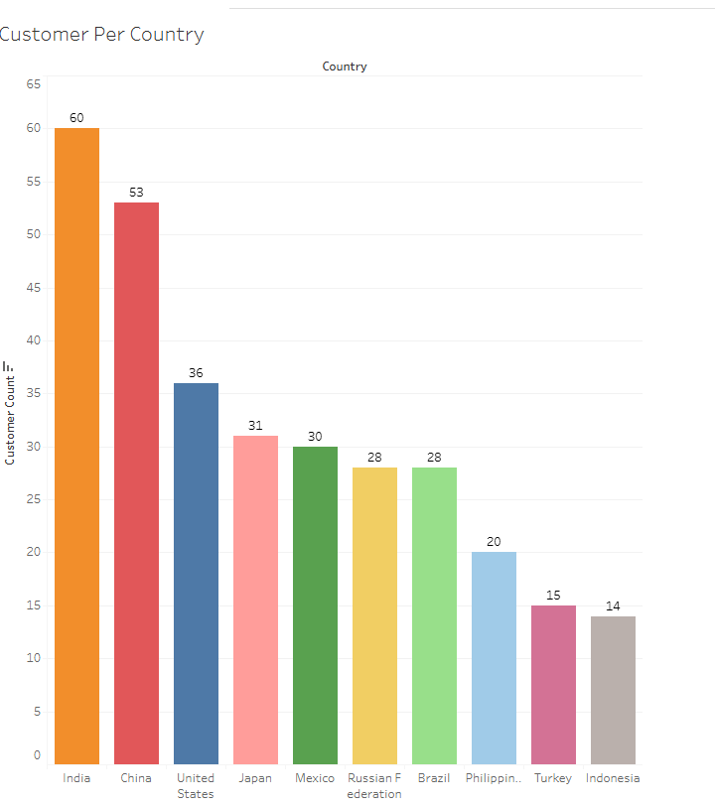
Analysis
Here you can see the top 10 countries with the highest customer base
India and China make up a large portion of the customer base
On average, the more customers per country, the more revenue that country earns

Slide 27
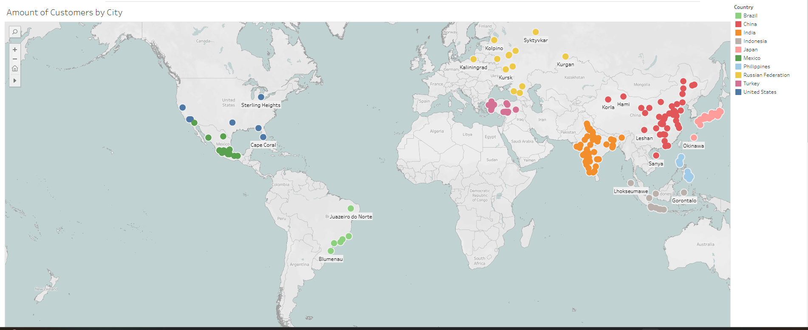
Analysis
Similarly to the country breakdown, we see a lot of cities in India and China have the greatest amount of customers

Slide 28
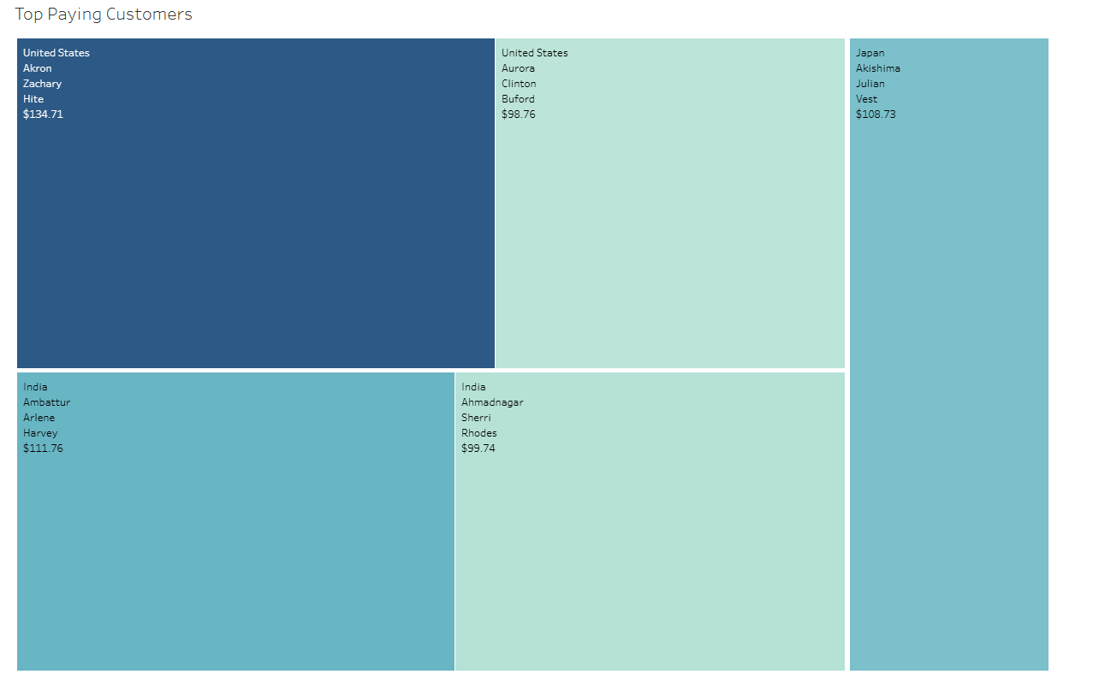
Analysis
Here we can see unlike a lot of the previous data, the top paying customers actually reside in the USA.
However, this isn’t they're stark of a difference between the other data as the United States is they're in total consumers per country

Slide 29

Summary
Customer Base: The largest customer groups are located in India, China, and the United States, indicating these regions drive most of the business.
Revenue Distribution: Asia and America contribute the majority of the company’s revenue, showing these markets hold the greatest potential for growth.
Movie Performance: Analysis shows that certain movies in the catalog have little to no rental activity, which suggests they are not appealing to customers.

Slide 30

Recommendations
Increase Marketing in Key Regions: Allocate more marketing resources to Asia and America, focusing on India, China, and the U.S., to capitalize on their strong customer bases.
Streamline the Movie Catalog: Remove underperforming movies with minimal or no rentals to save on licensing fees and invest in movies with higher demand.
Enhance Popular Offerings: Prioritize securing licenses for movies that are already popular or have potential to perform well in key regions, ensuring a stronger appeal to customers.
Localized Strategies: Consider tailoring content or promotions for regional audiences, particularly in India and China, to further boost engagement and rentals.

Slide 31
Instacart Grocery Basket Analysis
Instacart

Slide 32

InstaCart
Overview: Instacart, an online grocery platform accessible via a mobile app, provides customers with the convenience of shopping from home. This project examines its sales data to reveal customer purchasing patterns, aiding in the development of a targeted marketing strategy.
Methods:
Data Wrangling
Data Merging
Deriving Variables
Grouping Data
Aggregating Data
Reporting in Excel
Population Flows
Objectives:
Identify peak and low-order times to optimize advertising schedules and product marketing strategies
Analyze customer purchasing behaviors, including loyalty, demographics, and regional variations, to support targeted marketing efforts
Determine popular product categories and preferred price ranges to inform sales and promotional strategies
Data:
Open-source data sets from Instacart and a customer dataset from CareerFoundry. “The
Instacart Online Grocery Shopping Dataset 2017” , Accessed from www.instacart.com/datasets/groceryshopping-2017 via Kaggle on December 2024.
Tools Used

Slide 33
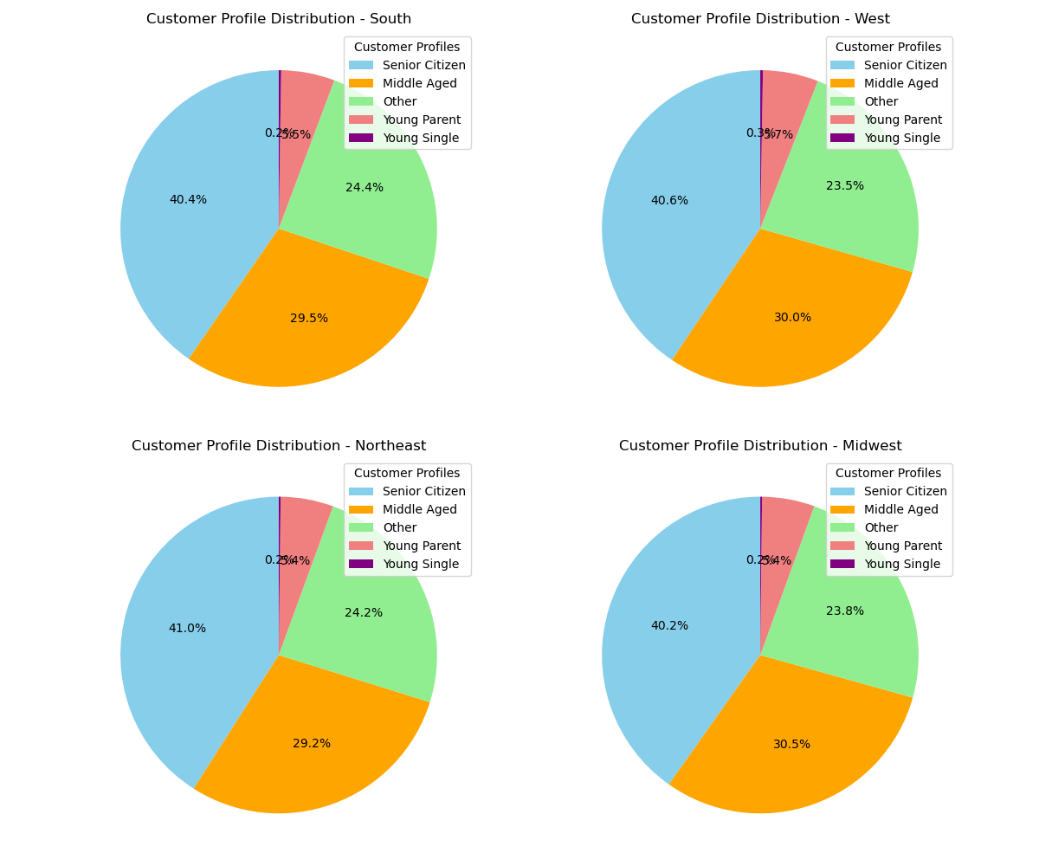
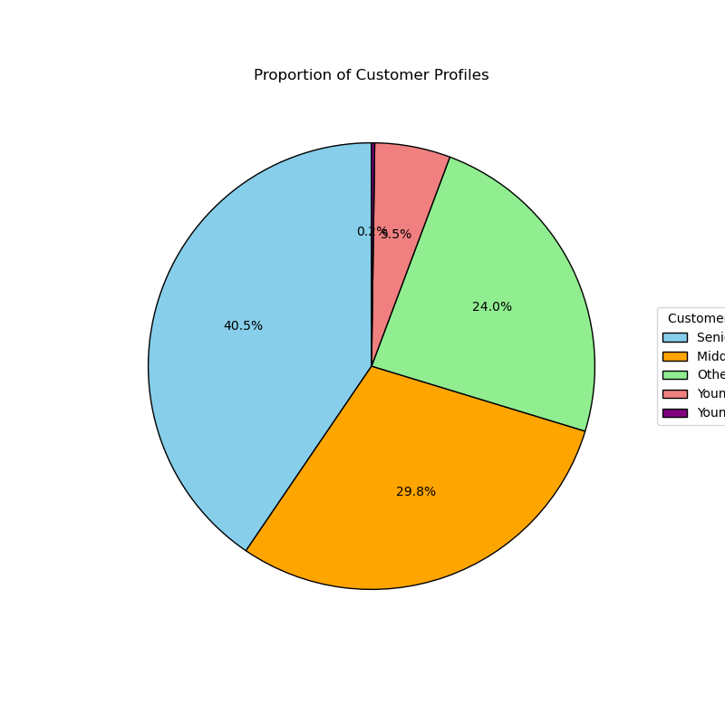
Visuals 1&2

Slide 34
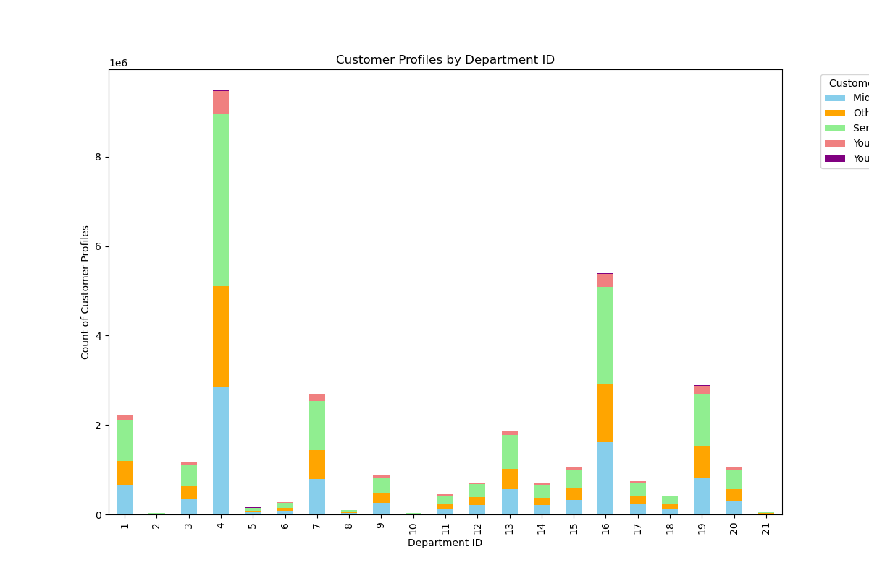
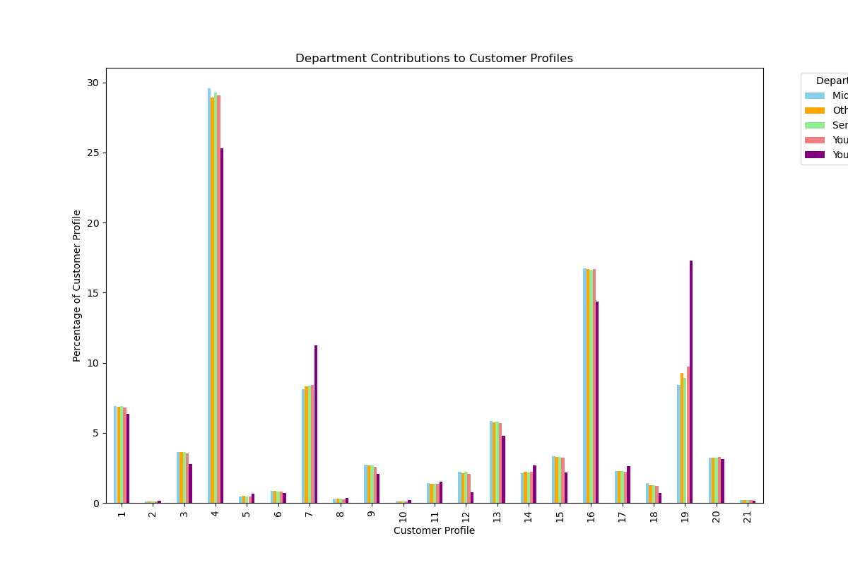
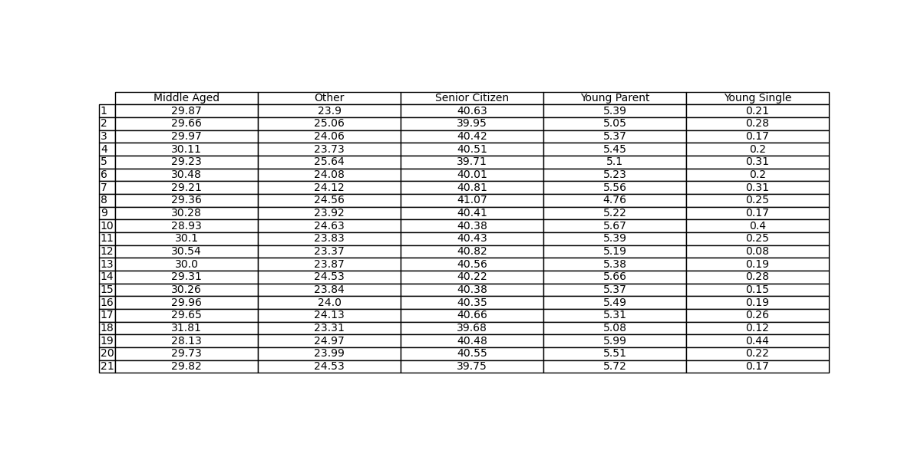
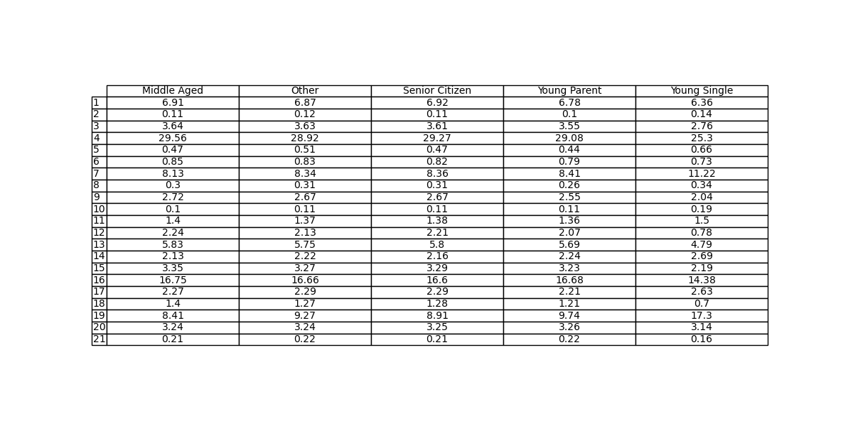
Visuals 3&4

Slide 35
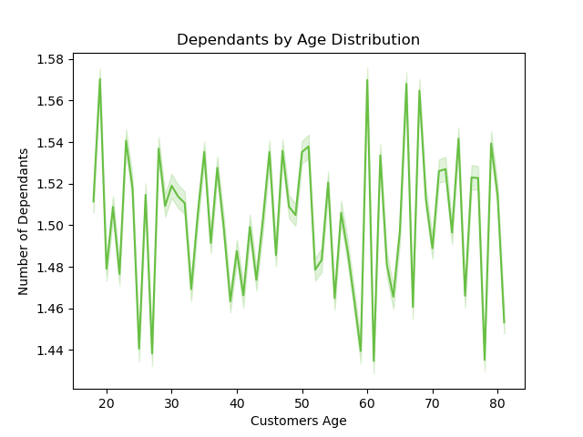
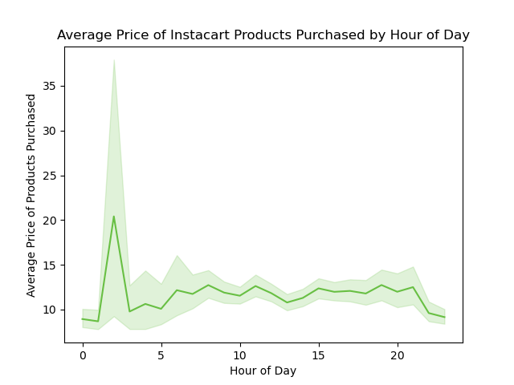
Visuals 5&6

Slide 36
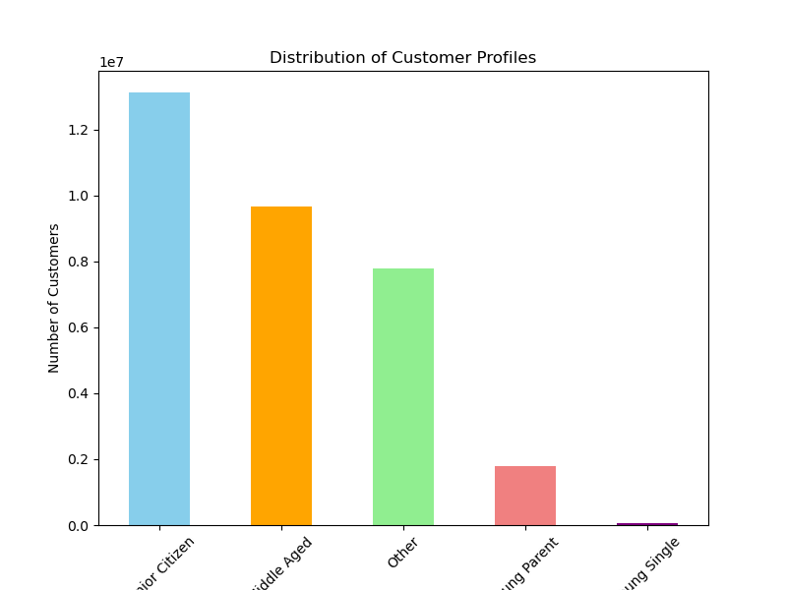
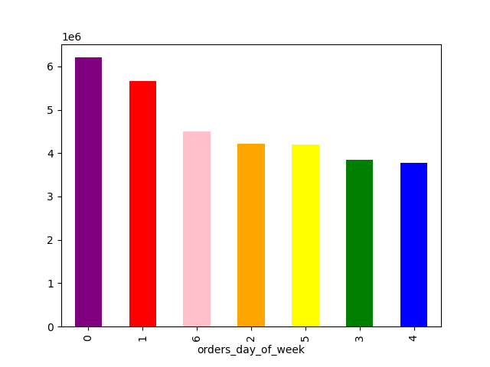
Visuals 7&8

Slide 37
Insights and Recommendations
The busiest shopping days are Saturday and Sunday, with peak hours from late morning to late afternoon (10 a.m. - 4 p.m.). Advertising efforts should focus on weekends during these times.
Spending is generally consistent throughout the day, with early mornings showing the highest spending, though likely an outlier. Advertising should remain consistent across all hours.
Produce (department 4) significantly outperforms all other departments, followed by dairy and eggs (department 16). Ads should target underperforming categories like frozen (1), beverages (7), and snacks (19) to boost sales.
Most customers place moderate orders ($10-$40), with loyal customers exceeding $40. To encourage higher spending, target new customers with promotions.
Ordering habits are consistent across regions. Younger customers (ages 26-35) spend the most on baby products (department 19), making them ideal for targeted ads.
Middle-aged and senior customers spend slightly more overall and order more frequently. Seniors may benefit from targeted campaigns but could face tech limitations. Middle-aged customers, the wealthiest group, are efficient shoppers but represent a key audience for promotions.

Slide 38
Pig E. Bank

Slide 39

Pig E. bank
Overview: E. Bank is a global financial institution with a specialized department focused on anti-money laundering compliance.
Methods:
Big Data
Data Ethics
Data Mining
Predictive Analysis
Time Series Forecasting and Analysis
Using GitHub
Objectives:
Identify key indicators of client attrition and propose strategies to improve customer retention
Data:
Provided by CarrerFoundry
Tools Used

Slide 40
Data Tables 1&2
Years Tenured vs Bank Exit
Count of ExitedFromBank? | Column Labels
Row Labels | No | Yes | Grand Total | % of Yes
0 | 32 | 6 | 38 | 16%
1 | 73 | 30 | 103 | 29%
2 | 83 | 27 | 110 | 25%
3 | 81 | 20 | 101 | 20%
4 | 69 | 17 | 86 | 20%
5 | 80 | 20 | 100 | 20%
6 | 73 | 21 | 94 | 22%
7 | 78 | 15 | 93 | 16%
8 | 88 | 20 | 108 | 19%
9 | 87 | 21 | 108 | 19%
10 | 43 | 7 | 50 | 14%
Grand Total | 787 | 204 | 991
Age group v Bank Exit
Count of ExitedFromBank? | Column Labels
Row Labels | No | Yes | Grand Total | % of Yes
18-30 | 169 | 12 | 181 | 7%
31-40 | 380 | 54 | 434 | 12%
41-50 | 158 | 82 | 240 | 34%
51-60 | 40 | 38 | 78 | 49%
61-70 | 21 | 16 | 37 | 43%
71-80 | 8 |  | 8 | 0%
81-90 | 1 |  | 1 | 0%
NULL | 10 | 2 | 12 | 17%
Grand Total | 787 | 204 | 991
Target Marketing schemes to those who are tenured between 1&6 years
Target Marketing schemes to those who are fall between the ages of 40&70

Slide 41
Data Tables 3,4&5
Active Member v Bank Exit
Count of ExitedFromBank? | Column Labels
Row Labels | No | Yes | Grand Total | % of Yes
No | 345 | 442 | 787 | 56%
Yes | 143 | 61 | 204 | 30%
Grand Total | 488 | 503 | 991
Income group v Bank Exit
Count of Age range | Column Labels
Row Labels | No | Yes | Grand Total | % of Yes
$0-$50,000 | 193 | 57 | 250 | 23%
$100,001-$150,000 | 207 | 53 | 260 | 20%
$150,001-$200,000 | 177 | 49 | 226 | 22%
$50,001-$100,000 | 208 | 45 | 253 | 18%
Above $200,000 | 2 |  | 2 | 0%
Grand Total | 787 | 204 | 991
Has a Credit Card v Bank Exit
Count of ExitedFromBank? | Column Labels
Row Labels | No | Yes | Grand Total | % of Yes
No | 231 | 556 | 787 | 71%
Yes | 60 | 144 | 204 | 71%
Grand Total | 291 | 700 | 991
Target those who are an active ,ember of the company. Based on the numbers, having a credit card doesn’t affect whether someone leaves. Additionally. Income group doesn’t seem to have any bearing either.

Slide 42
UFC Project

Slide 43
UFC Project
Overview: This project aims to analyze historical UFC fight data to identify patterns and factors that contribute to a fighter's success. The dataset, scraped from UFCStats using BeautifulSoup and processed with Pandas, compiles detailed fight statistics for every UFC event in history. Each row represents a single fight and includes performance metrics for both fighters—categorized as "red" and "blue" based on their corner placement. The dataset provides pre-fight statistics, such as significant strikes and takedowns, for each fighter, aggregated from their past fights (excluding the current one). The primary objective is to determine how these statistics correlate with fight outcomes and to build a predictive model for fight winners.
Hypothesis:
Fighters with superior significant strike and takedown statistics are more likely to win their fights. By analyzing trends in past performance, we can explore whether these metrics serve as reliable indicators of success in the octagon.
Objectives:
Data Exploration & Cleaning: Understand the structure and quality of the dataset, addressing any inconsistencies or missing values.
Feature Engineering & Selection: Identify key statistical indicators that contribute most to predicting fight outcomes.
Model Development: Train and evaluate machine learning models to predict fight winners based on historical performance data.
Insights & Visualization: Present findings on which statistics have the greatest impact on winning, providing valuable insights into UFC fight dynamics.
Data:
https://www.kaggle.com/datasets/rajeevw/ufcdata
Tools Used

Slide 44
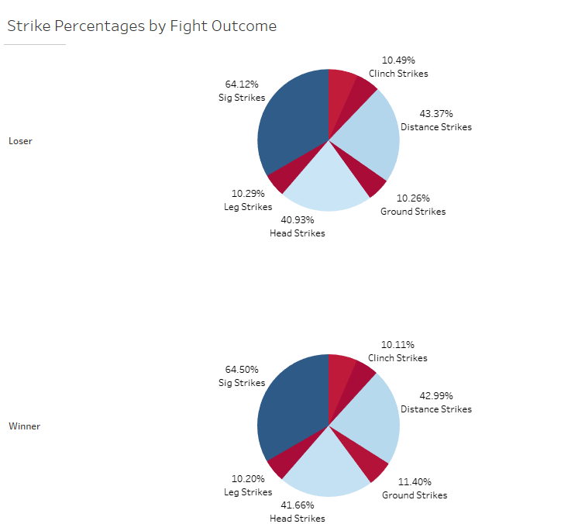
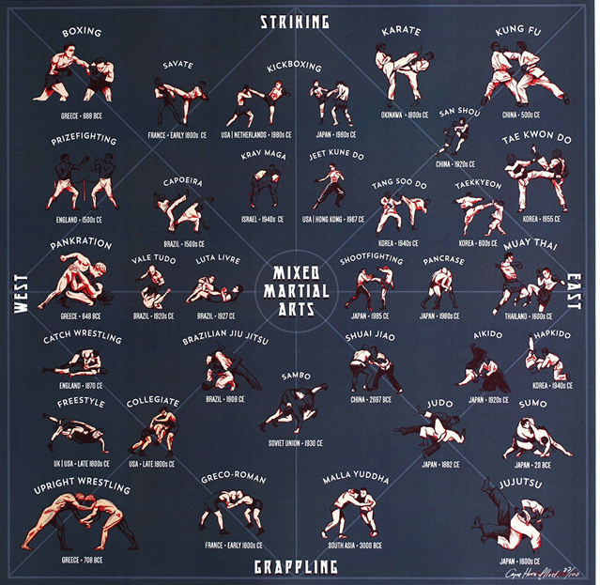
Pie Charts
From Looking at both of these breakdowns, although a small difference, It is important to note that the winner uses a higher percentage of significant strikes and ground strikes as opposed to the loser.

Slide 45
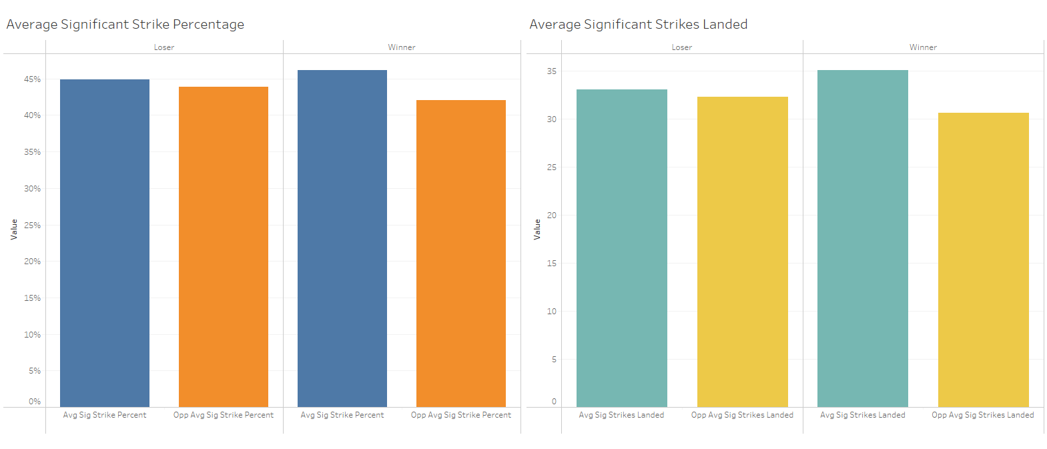
Bar Graphs Sig Strike
From these two visuals, one can see that the winner of the fight on average has a higher significant strike percentage along with more strikes landed. Their opponent on average has a lower significant strike percentage and less of those strikes landed.

Slide 46
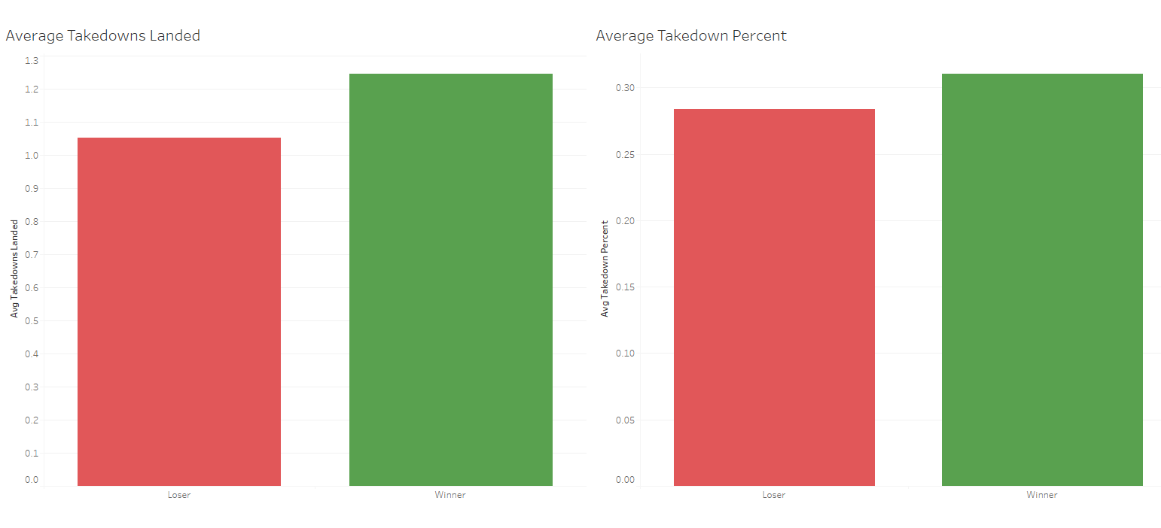
Bar Graphs Takedown
On average, the Winner of the fight has more takedowns landed along with a higher takedown percentage.

Slide 47
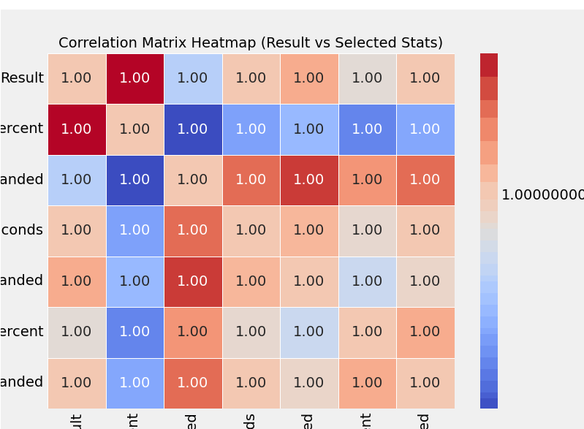
Correlation Breakdown
From this heat map we see that significant strikes shows the highest correlation with the result of winning, 1, and takedown percentage plays the second greatest role in the result of winning.
Sig strike is light blue, Takedown is in grey.

Slide 48
Conclusion
Based on our analysis, significant strikes emerged as the most crucial factor in determining fight outcomes. Fighters who landed more significant strikes had a strong correlation with winning, making it the most impactful metric.
Following significant strikes, takedowns also played an important role. While not as influential as striking volume and accuracy, the ability to secure takedowns contributed to a fighter's success, suggesting that effective grappling can be a key advantage.
We also explored factors outside of the fight itself, such as fight location, to see if external conditions influenced outcomes. However, our findings showed little to no impact, indicating that performance-based metrics remain the primary determinants of victory.
These insights reinforce the importance of striking efficiency and takedown success in fight strategy, while external elements like location appear to have minimal effect on the final result.
Analysis done in python:
http://localhost:8888/notebooks/CareerFoundry%20UFC%20Project/Supervised%20Machine%20Learning%20and%20Regression.ipynb?
http://localhost:8888/notebooks/CareerFoundry%20UFC%20Project/Unsupervised%20Machine%20Learning%20Clustering.ipynb?
http://localhost:8888/notebooks/CareerFoundry%20UFC%20Project/UFC_Project_Code.ipynb?
http://localhost:8888/notebooks/CareerFoundry%20UFC%20Project/Exploring%20Relationships.ipynb?

Slide 49



Thank you
Noah Vaknin
noahvaknin2@gmail.com
www.linkedin.com/in/noah-vaknin-binghamton2024

